Slide 1
Insert PPT to Joomla
Unioffices

Slide 2
Download & Install
Download (Download File Embed Extension)
https://www.powr.io/joomla/pkg_powfileembed.zip
Install it to Joomla platform
Extensions->install->Upload Package File->choose file->Upload and install
Active the file which you download
Extensions->Module Manager->click on POWrFile Embed Extension

Slide 3
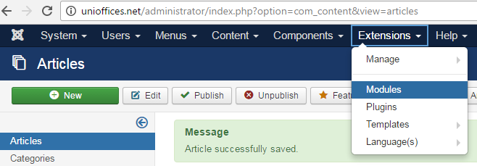
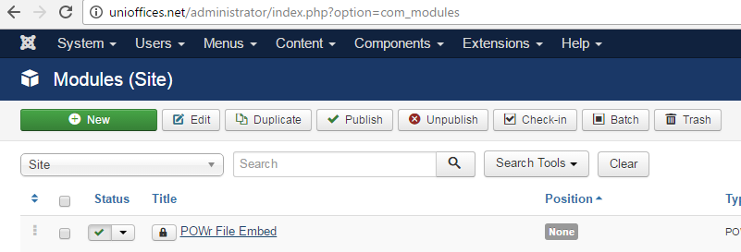
Add to page
Select the Extensions then go to Modules and active the mod_powr.
Select the File.

Slide 4
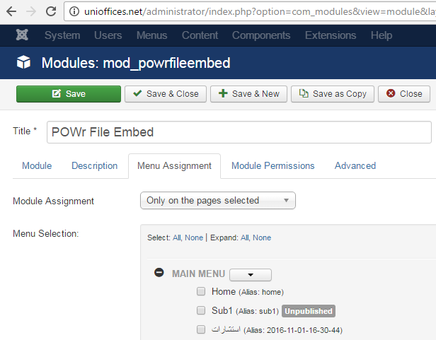
Add to page
Select the Menu Assignment tab
Select the page you like to add the PPT to it.
Only on the page selected.
Select None
Then select your articles name.
Save & Close.

